Slide 1
Solar Energy Calculator
-
Group 2
L. Hamacek, A. Hussain, C. Höglund, J. Larsson, S. Lindgren & A. Reddy

Slide 2
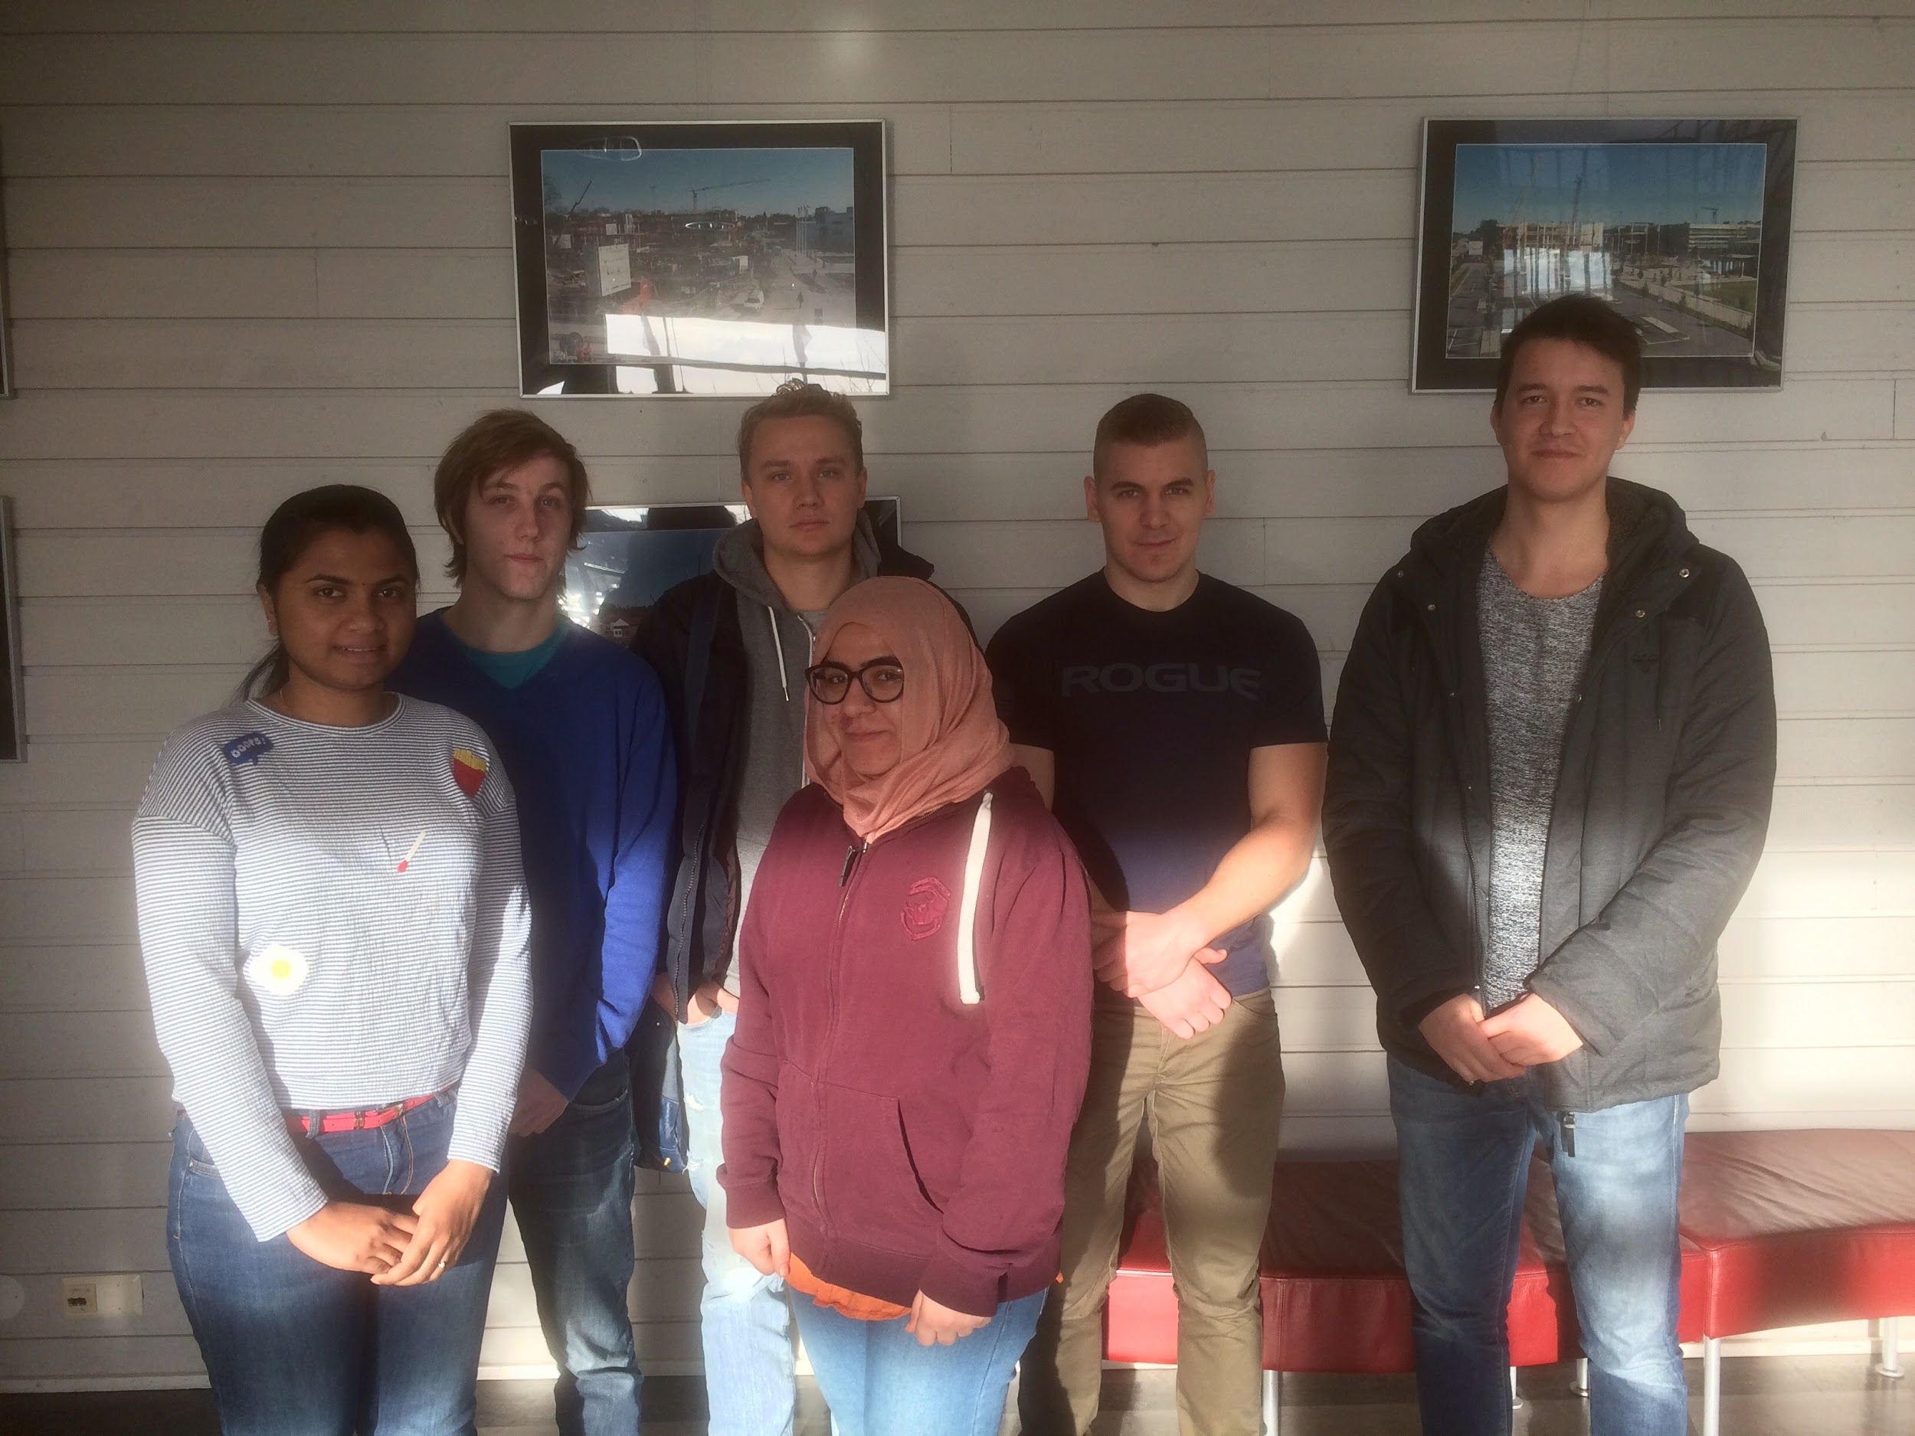
Project group
Lukas Hamacek - Project manager Aliya Hussain - Documentation and presentation Charlie Höglund - Trello manager Jonathan Larsson - Configuration manager (Github) Sebastian Lindgren - Client contact Avalika Podduturu Reddy - Report overseer and designer

Slide 3

General information about solar energy
Photovoltaics (PV) covers the conversion of light into electricity using semiconducting materials
A typical photovoltaic system employs solar panels, each comprising a number of solar cells, which generate electrical power
More people are getting interested in using solar energy, and therefore there is a need for a solar energy calculator that helps the user to understand costs etcetera
Source: https://en.wikipedia.org/wiki/Photovoltaics
Notes:
the two first points are text from the wikipedia link.

Slide 4
The client
Bengt Stridh:
researcher at the Future Energy Center research specialization at MDH
developed detailed models in previous projects to analyze investment decisions for photovoltaic (PV) plants in Sweden, together with his colleagues
the current calculator based on these models is inside an Excel file, which uses built in functions to calculate the results

Slide 5
The client’s problem / Our task
Develop a web-based tool/calculator that helps the users to determine what investments in solar energy that are suitable for them
The potential users are both private persons and others (e.g. companies, property owners and cities)
Problem: Very few users have enough knowledge about PV (i.e. solar energy) and there are a lot of necessary parameters to be inputted for the calculations

Slide 6
Communication and synchronization
External:
The monday meeting with the steering group
At least 1 meeting per week with the client (physical or non-physical)
Internal:
At least 1-2 internal meetings per week (physical or non-physical)
We use “slack” or email for distant communication and synchronization
Github repository - share documents, code etcetera
OBS. Most of the work will be done individually and be synchronized over slack/meetings. However, if necessary we will work in pairs for more difficult tasks.

Slide 7
Interactions with the client - So far
Two meetings:
1. Phone meeting (11/14/2016)
Discussed the given project description. Also cleared out some points regarding the user’s input/output values, and priority of extra features.
2. Meeting at MDH (11/22/2016)
The client went through the Excel files containing the calculator and input/output values. We discussed some functionality of the calculator. We also showed the client a simple demo of the website.
OBS. The client gave us detailed requirements (i.e. the project scope), and during the meetings we let the client decide the priority of for example extra features.
Notes:
Two meetings 1- phone meeting (11/14/2016) Spoke to the client on the phone to discuss about the project descriptions. Cleared the points regarding the user inputs and output values 2- meeting at mdh (11/22/2016) spoke to the client and showed the demo of the website discussed functionality of the calculator

Slide 8
The system (web-based tool/calculator)
Input:
A lot of default parameter values (i.e. a slight difference between private persons and others regarding for example taxes)
Output:
Production cost
Profitability
Cash flow (i.e. yearly)
Diagrams (e.g. pie charts with the results)
A report file containing the results that could be printed
OBS. Important feature: Update for example the possible default values, min and max values by uploading a file (e.g. Excel) to the website

Slide 9
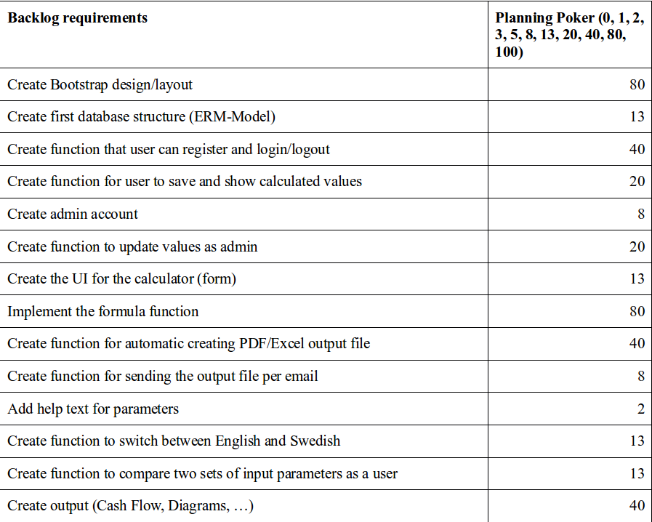
The initial backlog
Also the extra features (ranked):
1. Compare the calculated values for two sets of input parameters.
2. Save the used input values from one session to another session at a later time.
3. Switch between Swedish and English language.

Slide 10
Important non-functional requirements
User-friendly interaction and ease of use is very important, since not as many users know what necessary values to input for the calculations
OBS. This will be solved by using default parameter values, min and max values, guiding texts etcetera.

Slide 11
The implementation so far (live demo)
We will now show you a simple demo website that we have created.

Slide 12

ANY QUESTIONS?

